Slide 1


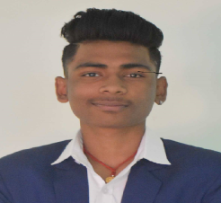
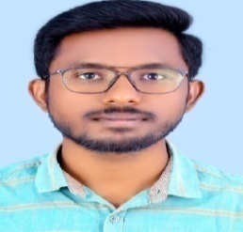
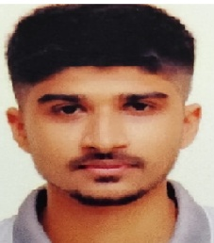
Name : ABHIJIT RAJENDRA AKHANDE
PG-DAC February-25 Batch
PRN No : 250243120002
Blood Group: O +
Name: ABHAY YADAV
PG-DAC February-25 Batch
PRN No : 250243120001
Blood Group: B+
Name : ABHISHEK ANAND
PG-DAC February-25 Batch
PRN No : 250243120003 Blood Group: O +
3rd Floor, Commerce Centre,
Paud Road, Kothrud, Pune - 38.
Telefax : 41311269, 41312111
3rd Floor, Commerce Centre,
Paud Road, Kothrud, Pune - 38.
Telefax : 41311269, 41312111
3rd Floor, Commerce Centre,
Paud Road, Kothrud, Pune - 38.
Telefax : 41311269, 41312111

Slide 2
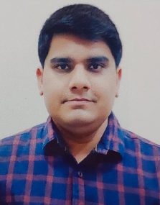
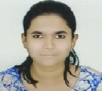
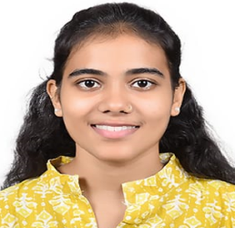
Name: ADITYA KAPIL
PG-DAC February-25 Batch
PRN No : 250243120004
Blood Group: A-
Name : AISHWARYA AKADE
PG-DAC February-25 Batch
PRN No : 250243120005
Blood Group:A +
Name : AKANKSHA PRADEEP CHAVAN
PG-DAC February-25 Batch
PRN No : 250243120006
Blood Group:O +
3rd Floor, Commerce Centre,
Paud Road, Kothrud, Pune - 38.
Telefax : 41311269, 41312111
3rd Floor, Commerce Centre,
Paud Road, Kothrud, Pune - 38.
Telefax : 41311269, 41312111
3rd Floor, Commerce Centre,
Paud Road, Kothrud, Pune - 38.
Telefax : 41311269, 41312111

Slide 3

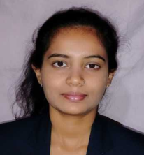

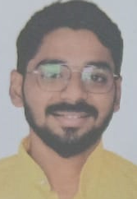
Name : ANKITA DNYANESHWAR NAVPUTE
PG-DAC February-25 Batch
PRN No : 250243120007
Blood Group: AB+
Name : ARYAN SAHU
PG-DAC February-25 Batch
PRN No : 250243120008
Blood Group: B+
Name : ASHMIT CHAUDHARY
PG-DAC February-25 Batch
PRN No : 250243120009
Blood Group: O+
3rd Floor, Commerce Centre,
Paud Road, Kothrud, Pune - 38.
Telefax : 41311269, 41312111
3rd Floor, Commerce Centre,
Paud Road, Kothrud, Pune - 38.
Telefax : 41311269, 41312111
3rd Floor, Commerce Centre,
Paud Road, Kothrud, Pune - 38.
Telefax : 41311269, 41312111

Slide 4
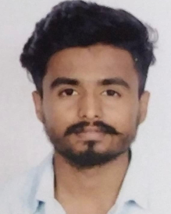
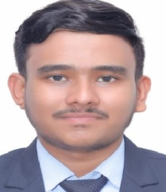
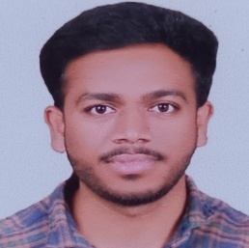
Name : AYUSH DIPAKRAO DESHMUKH
PG-DAC February-25 Batch
PRN No : 250243120011
Blood Group: A+
Name : BALAJI SAUDAGAR PAWAR
PG-DAC February-25 Batch
PRN No : 250243120012
Blood Group: O+
Name : ASHUTOSH BARDE
PG-DAC February-25 Batch
PRN No : 250243120010
Blood Group: B+
3rd Floor, Commerce Centre,
Paud Road, Kothrud, Pune - 38.
Telefax : 41311269, 41312111
3rd Floor, Commerce Centre,
Paud Road, Kothrud, Pune - 38.
Telefax : 41311269, 41312111
3rd Floor, Commerce Centre,
Paud Road, Kothrud, Pune - 38.
Telefax : 41311269, 41312111

Slide 5

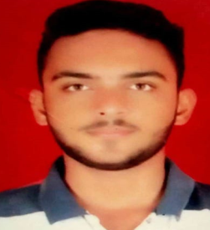
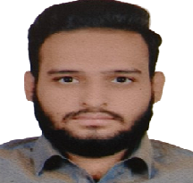
Name : CHAITANYA SANJAY AVHAD
PG-DAC February-25 Batch
PRN No : 250243120013
Blood Group: AB+
Name : DHAMDHERE TEJAS ADINATH
PG-DAC February-25 Batch
PRN No : 250243120014
Blood Group: O+
Name : DIGVIJAY SHANKAR DEVARE
PG-DAC February-25 Batch
PRN No : 250243120015
Blood Group: A +
3rd Floor, Commerce Centre,
Paud Road, Kothrud, Pune - 38.
Telefax : 41311269, 41312111
3rd Floor, Commerce Centre,
Paud Road, Kothrud, Pune - 38.
Telefax : 41311269, 41312111
3rd Floor, Commerce Centre,
Paud Road, Kothrud, Pune - 38.
Telefax : 41311269, 41312111

Slide 6
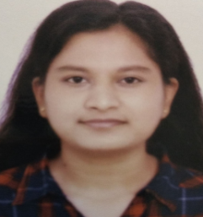
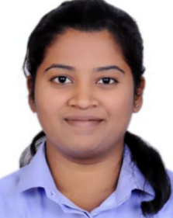
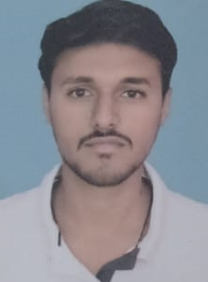
Name : GAIKWAD TRUPTI UTTAM
PG-DAC February-25 Batch
PRN No : 250243120017
Blood Group: O +
Name : HARKARE SANGMESHWAR MALLIKARUN
PG-DAC February-25 Batch
PRN No : 250243120018
Blood Group: O +
Name : DIMPLE PATIL
PG-DAC February-25 Batch
PRN No : 250243120016
Blood Group: A +
3rd Floor, Commerce Centre,
Paud Road, Kothrud, Pune - 38.
Telefax : 41311269, 41312111
3rd Floor, Commerce Centre,
Paud Road, Kothrud, Pune - 38.
Telefax : 41311269, 41312111
3rd Floor, Commerce Centre,
Paud Road, Kothrud, Pune - 38.
Telefax : 41311269, 41312111

Slide 7
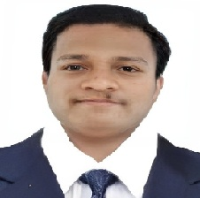
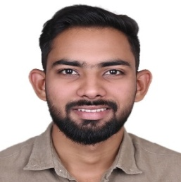
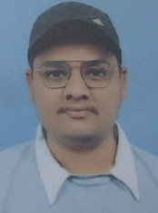
Name : HENIL YUORAJ AHIRE
PG-DAC February-25 Batch
PRN No : 250243120020
Blood Group: O+
Name : HIMANSHU ANIL DHOBLE
PG-DAC February-25 Batch
PRN No : 250243120021
Blood Group: B +
Name : HARSH VIJAY KATKAR
PG-DAC February-25 Batch
PRN No : 250243120019
Blood Group: O +
3rd Floor, Commerce Centre,
Paud Road, Kothrud, Pune - 38.
Telefax : 41311269, 41312111
3rd Floor, Commerce Centre,
Paud Road, Kothrud, Pune - 38.
Telefax : 41311269, 41312111
3rd Floor, Commerce Centre,
Paud Road, Kothrud, Pune - 38.
Telefax : 41311269, 41312111

Slide 8
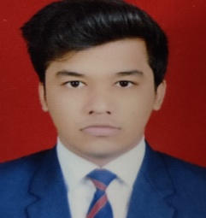
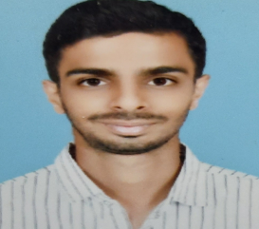
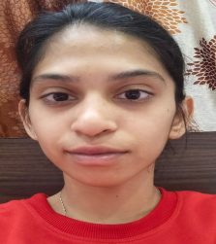
Name : HIMANSHU SONI
PG-DAC February-25 Batch
PRN No : 250243120022
Blood Group : A+
Name: ISHAN SACHIN AHIRRAO
PG-DAC February-25 Batch
PRN No : 250243120023
Blood Group: B+
Name : JANHVI SATISH SHIRSAT
PG-DAC February-25 Batch
PRN No : 250243120024
Blood Group: O+
3rd Floor, Commerce Centre,
Paud Road, Kothrud, Pune - 38.
Telefax : 41311269, 41312111
3rd Floor, Commerce Centre,
Paud Road, Kothrud, Pune - 38.
Telefax : 41311269, 41312111
3rd Floor, Commerce Centre,
Paud Road, Kothrud, Pune - 38.
Telefax : 41311269, 41312111

Slide 9
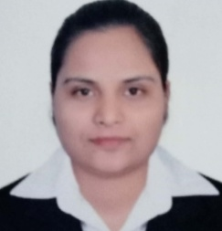
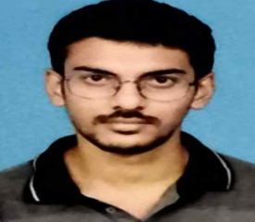
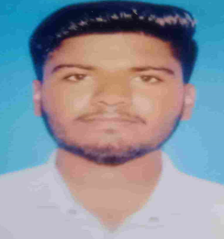
Name : JYOTSANA SATISH PANDHARE
PG-DAC February-25 Batch
PRN No : 250243120025
Blood Group: B+
Name : K HARSHAVARDHANRAJU
PG-DAC February-25 Batch
PRN No : 250243120026
Blood Group: B +
Name : MALI SAGAR ASHOK
PG-DAC February-25 Batch
PRN No : 250243120027
Blood Group: A +
3rd Floor, Commerce Centre,
Paud Road, Kothrud, Pune - 38.
Telefax : 41311269, 41312111
3rd Floor, Commerce Centre,
Paud Road, Kothrud, Pune - 38.
Telefax : 41311269, 41312111
3rd Floor, Commerce Centre,
Paud Road, Kothrud, Pune - 38.
Telefax : 41311269, 41312111

Slide 10
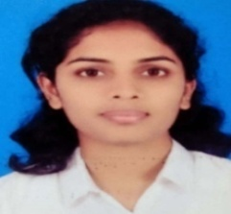

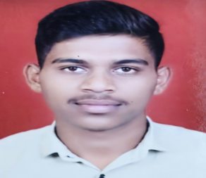
Name : MANE SHRAVANI RAJESH
PG-DAC February-25 Batch
PRN No : 250243120028
Blood Group: O +
Name : MANISH PRATAP AHUJA
PG-DAC February-25 Batch
PRN No : 250243120029
Blood Group: B+
Name :MAYUR JAVARE
PG-DAC February-25 Batch
PRN No : 250243120030
Blood Group: A +
3rd Floor, Commerce Centre,
Paud Road, Kothrud, Pune - 38.
Telefax : 41311269, 41312111
3rd Floor, Commerce Centre,
Paud Road, Kothrud, Pune - 38.
Telefax : 41311269, 41312111
3rd Floor, Commerce Centre,
Paud Road, Kothrud, Pune - 38.
Telefax : 41311269, 41312111

Slide 11
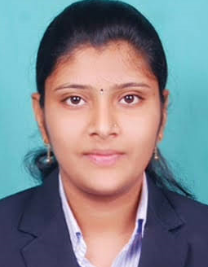
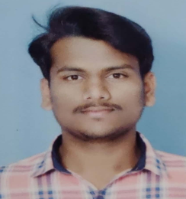
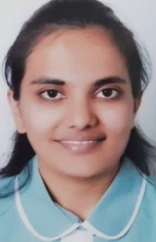
Name : MAYURI RAJENDRA PATIL
PG-DAC February-25 Batch
PRN No : 250243120031
Blood Group: O+
Name : MENGAWADE SIDDHARTH SUBHASH
PG-DAC February-25 Batch
PRN No : 250243120032
Blood Group: B+
Name : MRUNAL RAJENDRA DESAI
PG-DAC February-25 Batch
PRN No : 250243120033
Blood Group: O +
3rd Floor, Commerce Centre,
Paud Road, Kothrud, Pune - 38.
Telefax : 41311269, 41312111
3rd Floor, Commerce Centre,
Paud Road, Kothrud, Pune - 38.
Telefax : 41311269, 41312111
3rd Floor, Commerce Centre,
Paud Road, Kothrud, Pune - 38.
Telefax : 41311269, 41312111

Slide 12


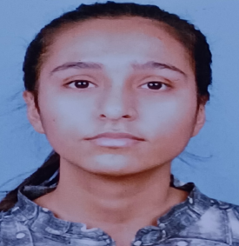
Name : MUNDHE YASH BHAGWAN
PG-DAC February-25 Batch
PRN No : 250243120034
Blood Group: B +
Name : MUSHARAF HANIEF
PG-DAC February-25 Batch
PRN No : 250243120035
Blood Group: B +
Name : NANDANI
PG-DAC February-25 Batch
PRN No : 250243120036
Blood Group: B +
3rd Floor, Commerce Centre,
Paud Road, Kothrud, Pune - 38.
Telefax : 41311269, 41312111
3rd Floor, Commerce Centre,
Paud Road, Kothrud, Pune - 38.
Telefax : 41311269, 41312111
3rd Floor, Commerce Centre,
Paud Road, Kothrud, Pune - 38.
Telefax : 41311269, 41312111

Slide 13
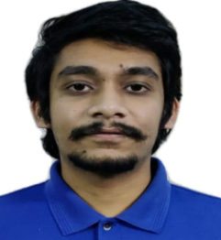
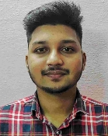
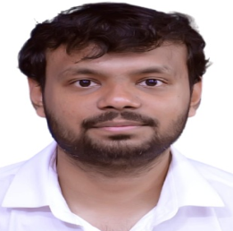
Name : NAVNEET KURREY
PG-DAC February-25 Batch
PRN No : 250243120037
Blood Group: B+
Name : NIKHIL KUMAR SAHU
PG-DAC February-25 Batch
PRN No : 250243120038
Blood Group: O+
Name :NIKHIL SALWADE
PG-DAC February-25 Batch
PRN No : 250243120039
Blood Group: O +
3rd Floor, Commerce Centre,
Paud Road, Kothrud, Pune - 38.
Telefax : 41311269, 41312111
3rd Floor, Commerce Centre,
Paud Road, Kothrud, Pune - 38.
Telefax : 41311269, 41312111
3rd Floor, Commerce Centre,
Paud Road, Kothrud, Pune - 38.
Telefax : 41311269, 41312111

Slide 14
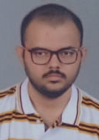
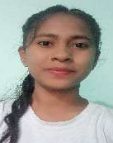
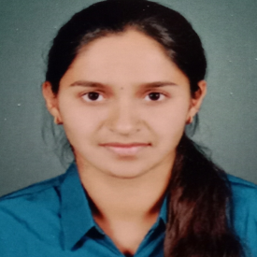
Name : NIKHIL VIJAY PATIL
PG-DAC February-25 Batch
PRN No : 250243120040
Blood Group: A+
Name : NIKITA SUNIL ZODE
PG-DAC February-25 Batch
PRN No : 250243120041
Blood Group: O +
Name : NUTAN SANTOSH BHILARE
PG-DAC February-25 Batch
PRN No : 250243120042
Blood Group: A+
3rd Floor, Commerce Centre,
Paud Road, Kothrud, Pune - 38.
Telefax : 41311269, 41312111
3rd Floor, Commerce Centre,
Paud Road, Kothrud, Pune - 38.
Telefax : 41311269, 41312111
3rd Floor, Commerce Centre,
Paud Road, Kothrud, Pune - 38.
Telefax : 41311269, 41312111

Slide 15
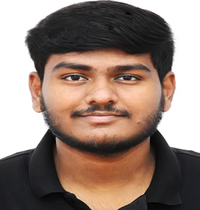

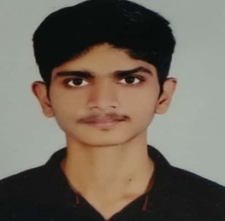
Name :OMKAR KANCHARLAWAR
PG-DAC February-25 Batch
PRN No : 250243120044
Blood Group: O+
Name : OMKAR NAVNATH KEDARI
PG-DAC February-25 Batch
PRN No : 250243120045
Blood Group: B+
Name : OMKAR GEETARAM TAKALKAR
PG-DAC February-25 Batch
PRN No : 250243120043
Blood Group: A+
3rd Floor, Commerce Centre,
Paud Road, Kothrud, Pune - 38.
Telefax : 41311269, 41312111
3rd Floor, Commerce Centre,
Paud Road, Kothrud, Pune - 38.
Telefax : 41311269, 41312111
3rd Floor, Commerce Centre,
Paud Road, Kothrud, Pune - 38.
Telefax : 41311269, 41312111

Slide 16
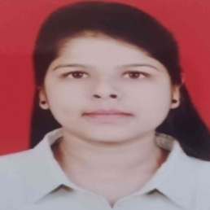
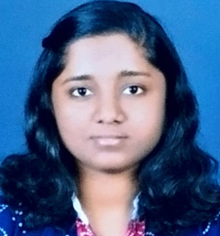
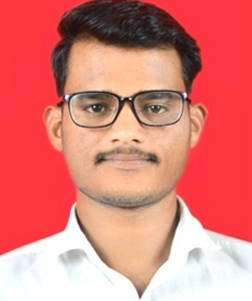
Name : PALLAVI SANTOSH DEVARE
PG-DAC February-25 Batch
PRN No : 250243120046
Blood Group: B +
Name :PATIL RUCHA SANJAY
PG-DAC February-25 Batch
PRN No : 250243120047
Blood Group: B+
Name : PAWAN SHANKAR LEKURWALE
PG-DAC February-25 Batch
PRN No : 250243120048
Blood Group: A+
3rd Floor, Commerce Centre,
Paud Road, Kothrud, Pune - 38.
Telefax : 41311269, 41312111
3rd Floor, Commerce Centre,
Paud Road, Kothrud, Pune - 38.
Telefax : 41311269, 41312111
3rd Floor, Commerce Centre,
Paud Road, Kothrud, Pune - 38.
Telefax : 41311269, 41312111

Slide 17
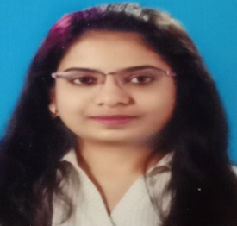
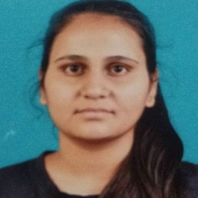
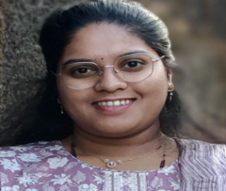
Name : PRADNYA SUNIL GHUHE
PG-DAC February-25 Batch
PRN No : 250243120049
Blood Group:AB +
Name : PRANALI KESHAVRAO GONDCHAWAR
PG-DAC February-25 Batch
PRN No : 250243120050
Blood Group: O +
Name : PRANALI SAMBHAJI AROTE
PG-DAC February-25 Batch
PRN No : 250243120051
Blood Group: A+
3rd Floor, Commerce Centre,
Paud Road, Kothrud, Pune - 38.
Telefax : 41311269, 41312111
3rd Floor, Commerce Centre,
Paud Road, Kothrud, Pune - 38.
Telefax : 41311269, 41312111
3rd Floor, Commerce Centre,
Paud Road, Kothrud, Pune - 38.
Telefax : 41311269, 41312111

Slide 18
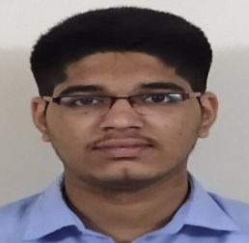
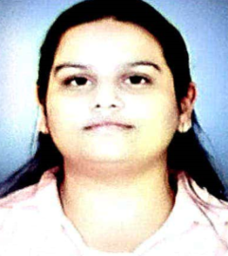

Name : PRANAV SANJAY JADHAWAR
PG-DAC February-25 Batch
PRN No : 250243120052
Blood Group: A+
Name : PRANJAL SHARMA
PG-DAC February-25 Batch
PRN No : 250243120053
Blood Group: A +
Name :PRASAD RAVINDRA PATIL
PG-DAC February-25 Batch
PRN No : 250243120054
Blood Group: AB +
3rd Floor, Commerce Centre,
Paud Road, Kothrud, Pune - 38.
Telefax : 41311269, 41312111
3rd Floor, Commerce Centre,
Paud Road, Kothrud, Pune - 38.
Telefax : 41311269, 41312111
3rd Floor, Commerce Centre,
Paud Road, Kothrud, Pune - 38.
Telefax : 41311269, 41312111

Slide 19
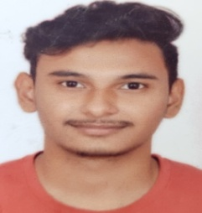
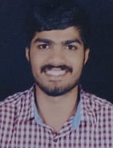
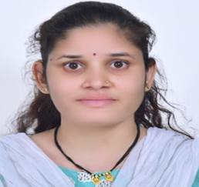
Name : PRATHAM SHAH
PG-DAC February-25 Batch
PRN No : 250243120055
Blood Group: A+
Name : PRATIK KAMTHE
PG-DAC February-25 Batch
PRN No : 250243120056
Blood Group: O+
Name :PRATIKSHA UTTAM MORE
PG-DAC February-25 Batch
PRN No : 250243120057
Blood Group: B +
3rd Floor, Commerce Centre,
Paud Road, Kothrud, Pune - 38.
Telefax : 41311269, 41312111
3rd Floor, Commerce Centre,
Paud Road, Kothrud, Pune - 38.
Telefax : 41311269, 41312111
3rd Floor, Commerce Centre,
Paud Road, Kothrud, Pune - 38.
Telefax : 41311269, 41312111

Slide 20



Name : PRIYANKA NAVANATH SHINDE
PG-DAC February-25 Batch
PRN No :250243120058
Blood Group: AB+
Name : RACHANA SANJAY PATIL
PG-DAC February-25 Batch
PRN No : 250243120059
Blood Group: A+
Name : RAHUL MALIK
PG-DAC February-25 Batch
PRN No : 250243120060
Blood Group: B+
3rd Floor, Commerce Centre,
Paud Road, Kothrud, Pune - 38.
Telefax : 41311269, 41312111
3rd Floor, Commerce Centre,
Paud Road, Kothrud, Pune - 38.
Telefax : 41311269, 41312111
3rd Floor, Commerce Centre,
Paud Road, Kothrud, Pune - 38.
Telefax : 41311269, 41312111

Slide 21



Name : RAKESH KUSHWAHA
PG-DAC February-25 Batch
PRN No : 250243120061
Blood Group: O+
Name : RAVI PATIDAR
PG-DAC February-25 Batch
PRN No : 250243120062
Blood Group: B +
Name : RUPESH NEMICHAND MOHARE
PG-DAC February-25 Batch
PRN No : 250243120063
Blood Group: B+
3rd Floor, Commerce Centre,
Paud Road, Kothrud, Pune - 38.
Telefax : 41311269, 41312111
3rd Floor, Commerce Centre,
Paud Road, Kothrud, Pune - 38.
Telefax : 41311269, 41312111
3rd Floor, Commerce Centre,
Paud Road, Kothrud, Pune - 38.
Telefax : 41311269, 41312111

Slide 22



Name : SANJYOT DHANAJI PHADATARE
PG-DAC February-25 Batch
PRN No : 250243120065
Blood Group: O +
Name : SANKET PANDURANG SHINDE
PG-DAC February-25 Batch
PRN No : 250243120066
Blood Group: B
Name : SANIKA RAJESH NIMJE
PG-DAC February-25 Batch
PRN No : 250243120064
Blood Group: O+
3rd Floor, Commerce Centre,
Paud Road, Kothrud, Pune - 38.
Telefax : 41311269, 41312111
3rd Floor, Commerce Centre,
Paud Road, Kothrud, Pune - 38.
Telefax : 41311269, 41312111
3rd Floor, Commerce Centre,
Paud Road, Kothrud, Pune - 38.
Telefax : 41311269, 41312111

Slide 23



Name : SARIKA NARAYAN CHAWARE
PG-DAC February-25 Batch
PRN No : 250243120067
Blood Group: O +
Name : SHIVANI MADHUKAR PATIL
PG-DAC February-25 Batch
PRN No : 250243120068
Blood Group: O +
Name : SHOAIB DILAWAR NADAF
PG-DAC February-25 Batch
PRN No : 250243120069
Blood Group: A+
3rd Floor, Commerce Centre,
Paud Road, Kothrud, Pune - 38.
Telefax : 41311269, 41312111
3rd Floor, Commerce Centre,
Paud Road, Kothrud, Pune - 38.
Telefax : 41311269, 41312111
3rd Floor, Commerce Centre,
Paud Road, Kothrud, Pune - 38.
Telefax : 41311269, 41312111

Slide 24



Name : SHREYA HANUMANT SALUNKHE
PG-DAC February-25 Batch
PRN No : 250243120070
Blood Group: O +
Name : SHREYA NAVNATH NILAKH
PG-DAC February-25 Batch
PRN No : 250243120071
Blood Group:O +
Name : SHREYA SALUNKE
PG-DAC February-25 Batch
PRN No : 250243120072
Blood Group: O +
3rd Floor, Commerce Centre,
Paud Road, Kothrud, Pune - 38.
Telefax : 41311269, 41312111
3rd Floor, Commerce Centre,
Paud Road, Kothrud, Pune - 38.
Telefax : 41311269, 41312111
3rd Floor, Commerce Centre,
Paud Road, Kothrud, Pune - 38.
Telefax : 41311269, 41312111

Slide 25



Name : SHRUTI DEVCHAND SHAHARE
PG-DAC February-25 Batch
PRN No : 250243120073
Blood Group: AB +
Name : SUKANYA SATISH PATIL
PG-DAC February-25 Batch
PRN No : 250243120075
Blood Group: A +
Name : SNEHA ANIL BANSODE
PG-DAC February-25 Batch
PRN No : 250243120074
Blood Group: O+
3rd Floor, Commerce Centre,
Paud Road, Kothrud, Pune - 38.
Telefax : 41311269, 41312111
3rd Floor, Commerce Centre,
Paud Road, Kothrud, Pune - 38.
Telefax : 41311269, 41312111
3rd Floor, Commerce Centre,
Paud Road, Kothrud, Pune - 38.
Telefax : 41311269, 41312111

Slide 26



Name : SUMEDH SUHAS LOHARIKAR
PG-DAC February-25 Batch
PRN No : 250243120076
Blood Group:B +
Name : SURAJ DADAJI AHER
PG-DAC February-25 Batch
PRN No : 250243120077
Blood Group: O+
Name : TANISHAK TYAGI
PG-DAC February-25 Batch
PRN No : 250243120078
Blood Group: O+
3rd Floor, Commerce Centre,
Paud Road, Kothrud, Pune - 38.
Telefax : 41311269, 41312111
3rd Floor, Commerce Centre,
Paud Road, Kothrud, Pune - 38.
Telefax : 41311269, 41312111
3rd Floor, Commerce Centre,
Paud Road, Kothrud, Pune - 38.
Telefax : 41311269, 41312111

Slide 27



Name : TEJAS MAHENDRA JADHAV
PG-DAC February-25 Batch
PRN No : 250243120079
Blood Group: A +
Name : VAISHNAVI CHANDRAKANT BHOSALE
PG-DAC February-25 Batch
PRN No : 250243120081
Blood Group: A +
Name : UDIT SANADHYA
PG-DAC February-25 Batch
PRN No : 250243120080
Blood Group: AB+
3rd Floor, Commerce Centre,
Paud Road, Kothrud, Pune - 38.
Telefax : 41311269, 41312111
3rd Floor, Commerce Centre,
Paud Road, Kothrud, Pune - 38.
Telefax : 41311269, 41312111
3rd Floor, Commerce Centre,
Paud Road, Kothrud, Pune - 38.
Telefax : 41311269, 41312111

Slide 28



Name : VAISHNAVI RAMDAS HATTI
PG-DAC February-25 Batch
PRN No : 250243120082
Blood Group:A +
Name : VIKRANT PRAMOD KAMBLI
PG-DAC February-25 Batch
PRN No : 250243120083
Blood Group: B +
Name : VIRAJ MAHENDRA BHOSALE
PG-DAC February-25 Batch
PRN No : 250243120084
Blood Group: O+
3rd Floor, Commerce Centre,
Paud Road, Kothrud, Pune - 38.
Telefax : 41311269, 41312111
3rd Floor, Commerce Centre,
Paud Road, Kothrud, Pune - 38.
Telefax : 41311269, 41312111
3rd Floor, Commerce Centre,
Paud Road, Kothrud, Pune - 38.
Telefax : 41311269, 41312111

Slide 29



Name : VISHAKHA SATISHRAO KHANDAR
PG-DAC February-25 Batch
PRN No : 250243120085
Blood Group: O+
Name : VRUSHABH SUDHIR MESHRAM
PG-DAC February-25 Batch
PRN No : 250243120086
Blood Group: O +
Name : VYANKATESH DNYANDEV GAVALI
PG-DAC February-25 Batch
PRN No : 250243120087
Blood Group: B+
3rd Floor, Commerce Centre,
Paud Road, Kothrud, Pune - 38.
Telefax : 41311269, 41312111
3rd Floor, Commerce Centre,
Paud Road, Kothrud, Pune - 38.
Telefax : 41311269, 41312111
3rd Floor, Commerce Centre,
Paud Road, Kothrud, Pune - 38.
Telefax : 41311269, 41312111

Slide 30



Name : WARKE SEJAL VISHAL
PG-DAC February-25 Batch
PRN No : 250243120088
Blood Group: AB +
Name : YASH GAIKWAD
PG-DAC February-25 Batch
PRN No : 250243120089
Blood Group: O+
Name : YASH KUMAR
PG-DAC February-25 Batch
PRN No : 250243120090
Blood Group: B+
3rd Floor, Commerce Centre,
Paud Road, Kothrud, Pune - 38.
Telefax : 41311269, 41312111
3rd Floor, Commerce Centre,
Paud Road, Kothrud, Pune - 38.
Telefax : 41311269, 41312111
3rd Floor, Commerce Centre,
Paud Road, Kothrud, Pune - 38.
Telefax : 41311269, 41312111

Slide 31



Name : YOGESH VILAS BHAPKAR
PG-DAC February-25 Batch
PRN No : 250243120092
Blood Group: B+
Name : Tejas Vinayak Saratkar
PG-DAC February-25 Batch
PRN No : 250243120093
Blood Group: B+
Name : YASHIKA TYAGI
PG-DAC February-25 Batch
PRN No : 250243120091
Blood Group: B +
3rd Floor, Commerce Centre,
Paud Road, Kothrud, Pune - 38.
Telefax : 41311269, 41312111
3rd Floor, Commerce Centre,
Paud Road, Kothrud, Pune - 38.
Telefax : 41311269, 41312111
3rd Floor, Commerce Centre,
Paud Road, Kothrud, Pune - 38.
Telefax : 41311269, 41312111

